Slide 1
THE ENTREPRENEUR'S AI FIELD GUIDE · CLAUDE EDITION · APRIL 2026
Your Time Back.
Finally.
4
Challenges solved
80%
Less time on repetitive work
How Claude AI eliminates the 4 repetitive tasks that steal
entrepreneurs' most valuable hours — every single week.
∞
Hours freed for strategy
Powered by Claude · Anthropic · claude.ai
Notes:
Slide time: 1 minute

Slide 2





THE CHALLENGE
Repetition is stealing your ambition.
Product descriptions
Email & communication
Design & brand materials
Slides & presentations
4 REPETITIVE CHALLENGES
Notes:
Slide time: 3 minutes
Every small business owner knows the feeling: the day ends, tasks are checked off — but the work that truly moves the needle never quite got touched.
The culprit is always the same: repetition.
Writing the same kinds of descriptions.
Responding to similar emails.
Building decks from scratch.
Designing materials by trial and error.
Claude changes the equation. Not by replacing your judgment — but by handling the heavy lifting so your judgment can finally focus on the right things.

Slide 3
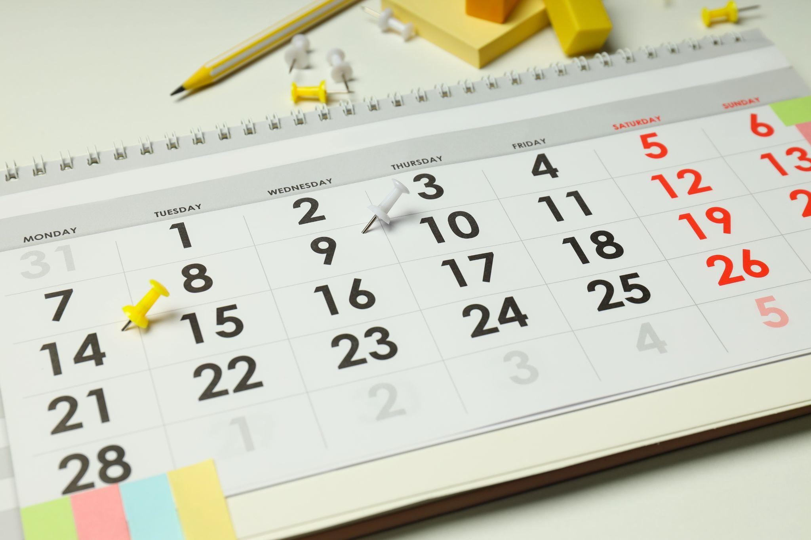

01
PRODUCT & SERVICE CATALOGS
Writing hundreds of
descriptions — one at a time
THE PROMPT PATTERN
"Write a 60-word description for [product]. Features: [list]. Tone: warm and approachable. Audience: busy parents."
At 15 minutes per description, a catalog of 100 items represents 25 hours of writing. Claude produces a polished description in seconds. That 25-hour task becomes an afternoon.
TIME SAVED PER ITEM
~14 minutes
BEST FOR
Shops, agencies, food producers, service directories
For any entrepreneur building a catalog — whether it's a boutique with 80 handmade items or a food producer with a seasonal menu — writing individual product descriptions is one of the most time-intensive tasks in the business.
Notes:
Slide time: 8 minutes
For any entrepreneur building a catalog — whether it's a boutique with 80 handmade items or a food producer with a seasonal menu — writing individual product descriptions is one of the most time-intensive tasks in the business.
At 15 minutes per description, a catalog of 100 items represents 25 hours of writing. Claude produces a polished description in seconds. That 25-hour task becomes an afternoon.
Entrepreneurs who once avoided expanding their catalog because of the writing burden can now scale their offerings without hesitation.

Slide 4


02
EMAIL & COMMUNICATIONS
Reading, filtering, and
responding to messages efficiently
WHAT CLAUDE CAN DO
"Summarize my unread emails, flag urgent ones, and draft replies for anything routine."
The average entrepreneur spends close to two hours a day in their inbox. Much of that time is on messages that follow predictable patterns — supplier inquiries, customer questions, scheduling requests, follow-ups.
Claude, connected to Gmail via its MCP connector, can read incoming messages, identify their intent and urgency, draft contextually appropriate responses, and — with your approval — send them.
Instead of being managed by your inbox, you manage it in a single focused review session. The inbox shrinks from a source of anxiety to a 20-minute daily task.
INTEGRATION
Claude + Gmail via MCP connector
AVG. TIME RECLAIMED
60–90 minutes per day
Notes:
Slide time: 10 minutes
The average entrepreneur spends close to two hours a day in their inbox. Much of that time is on messages that follow predictable patterns — supplier inquiries, customer questions, scheduling requests, follow-ups.
Claude, connected to Gmail via its MCP connector, can read incoming messages, identify their intent and urgency, draft contextually appropriate responses, and — with your approval — send them.
Instead of being managed by your inbox, you manage it in a single focused review session. The inbox shrinks from a source of anxiety to a 20-minute daily task.

Slide 5
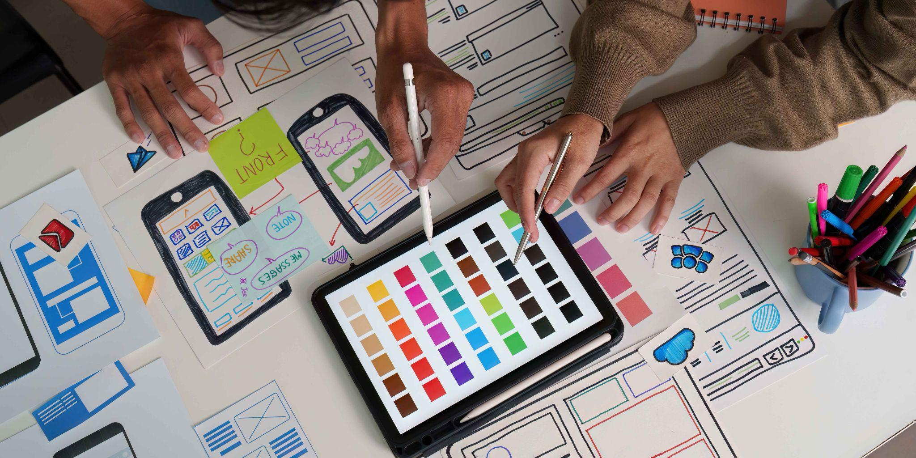
03
VISUAL DESIGN & BRAND MATERIALS
Creating professional designs
without a design team
EXAMPLE PROMPT
"Design a flyer for my Saturday tamale sale — warm earthy tones, handmade feel, space for price and location."
TOOL
Claude Design — claude.ai/design
EXPERIENCE NEEDED
Works for complete beginners
Notes:
Slide time: 10 minutes
Design has historically been one of the most gatekept skills in business. Either you hired a designer — expensive and slow — or you spent hours in Canva trying to make something that didn't embarrass you.
Claude Design, powered by Claude Opus 4.7, allows any entrepreneur to describe what they need in plain language and receive a fully editable, on-brand, professional design in return. Flyers, social media posts, pitch decks, landing pages — all generated from a sentence.
Your brand finally looks like it has a design team behind it — because it does.

Slide 6
04
PRESENTATIONS & SLIDE DECKS
Building compelling slides
from an idea in minutes
THE PROMPT
"Create a 7-slide investor pitch for my artisan coffee brand — professional tone, problem, solution, and market slide."
A presentation used to take a day. You'd outline it, write the content, fight with the formatting, find images, align the boxes, adjust the fonts — and still walk into the meeting hoping nobody noticed the inconsistencies.
Claude generates complete slide decks from a brief or outline. Give it your key points, your audience, your brand colors, and the number of slides — and it builds a coherent, well-structured deck in minutes.
The presentation that used to take a full day is now ready before your morning coffee cools down.
EXPORT OPTIONS
PPTX, PDF, Canva, HTML
AVERAGE BUILD TIME
Under 3 minutes
Notes:
Slide time: 4 minutes

Slide 7
THE NUMBERS
Hours saved every single week.
Product Descriptions
Email Management
Design Work
Presentations
BEFORE
BEFORE
BEFORE
BEFORE
25 hrs
10 hrs
8 hrs
6 hrs
AFTER
AFTER
AFTER
AFTER
2 hrs
2 hrs
1 hr
0.5 hr
SAVED
SAVED
SAVED
SAVED
23 hrs
8 hrs
7 hrs
5.5 hrs
Notes:
Slide time: 2 minutes

Slide 8
THE BIGGER PICTURE
When repetition disappears,
ambition can finally breathe.
Claude doesn't just save time — it changes what you are capable of attempting. When catalog descriptions take minutes instead of days, you can afford to launch that new product line. When your inbox doesn't own your mornings, you have space for the strategic conversation you've been postponing. When a slide deck is a 3-minute task, you say yes to more pitches, more opportunities, more visibility.
The entrepreneurs who move fastest in this era are the ones who recognize that AI handling the repetitive frees them to pursue the ambitious.
Catalog at scale — hundreds of descriptions, consistent voice · Smarter inbox — Claude drafts, you approve and move on · Instant design — professional materials from a single sentence · Decks in minutes — structured, polished, ready to export
Notes:
Slide time: 2 minutes

