Slide 1

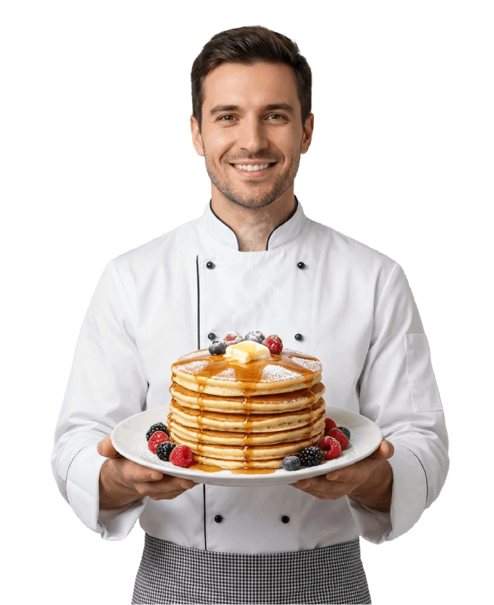
OPERATOR OPPORTUNITY · 2026
Spice up your life.
Operate the future
of Mexican food.
Delicias La Gloria is opening to a select group of operators. Bring our brand, kitchen, and full digital ecosystem to your city — backed by our team every step of the way.
Investment from $200K · Up to $1M+

Slide 2
THE CONCEPT
Authentic Mexican gastronomy, delivered home.
Tu lugar de sabor: dulce, crujiente y siempre delicioso.
75K+
01
Mexican comfort food
Tacos, tostadas, enchiladas, hotcakes, breakfasts, Mexican desserts. Recipes refined for consistency, packed for delivery, made fresh on order.
02
More than a restaurant
Customers already trust the brand
Despensa a casa (online supermarket), recargas (mobile top-ups), gift cards, and taxi referrals. One brand, multiple revenue streams.
03
Delivery-first, future-proof
Proven, tested, and ready to scale.
Built around the way people actually eat now. Fast delivery, secure payment, mobile ordering — the kitchen of the next decade, today.
Delicias La Gloria · Operator Opportunity
2 / 5

Slide 3
WHAT YOU GET
A turnkey ecosystem, not just a logo.
Everything you need to open the doors and start serving on day one.
1
Complete brand system
2
Storefront & app
3
POS, inventory, admin
Logo, color palette, typography, voice, and full design system used across every customer touchpoint.
Multilingual (8 languages) e-commerce site, mobile-ready, with payments, delivery, and order tracking.
Point of sale, supplier management, inventory, sales reports, and role-based admin tools — already built.
4
Despensa & recargas
5
Recipes & training
6
Ongoing operator support
Add the online supermarket and mobile top-up modules — extra revenue from the same kitchen.
Standardized recipes, prep guides, and on-site training for your kitchen and front-of-house team.
A dedicated success team for marketing, menu launches, vendor sourcing, and back-office help.
Delicias La Gloria · Operator Opportunity
3 / 5

Slide 4
THE INVESTMENT
Three ways to open Delicias La Gloria.
From a focused delivery kitchen to a full flagship — pick the format that fits your market.
★ MOST POPULAR ★
DELIVERY KITCHEN
NEIGHBORHOOD RESTAURANT
FLAGSHIP
Sabor
Familia
Patrón
$200K – $400K
$400K – $700K
$1M+
Cloud kitchen, delivery-first.
Dine-in plus delivery.
Anchor location, full ecosystem.
INCLUDES
INCLUDES
INCLUDES
Compact production kitchen
Storefront with seating (40–60)
Premium dine-in (80+ seats)
Full storefront & delivery app
Despensa a casa module
All modules unlocked
Brand, recipes, training
Recargas + gift cards
Multi-unit territory rights
POS + inventory
Co-marketing launch
Priority support team
All tiers include the brand system, recipes, training, ongoing operator support, and access to our digital platform. Tiers are reference ranges; actual investment depends on market, real estate, and format.
Delicias La Gloria · Operator Opportunity
4 / 5

Slide 5
BECOME AN OPERATOR
Tu lugar de sabor, en tu ciudad.
Bring Delicias La Gloria
to your city.
LET'S TALK
Operator inquiries
operators@
deliciaslagloria.com
Phone
01
Discovery call
Tell us about your market, budget, and timeline.
+52 (00) 0000-0000
Web
02
Tier & territory
We model the right format and exclusive territory together.
deliciaslagloria.com/operators
03
Open the doors
Sign, build, train, launch — typically 4–8 months.
Spice up your life. · Delicias La Gloria

